Slide 1


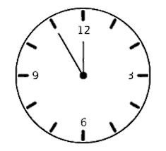



Development of a UNIVERSAL MEDICAL FORM READER
PDF
XML
HTML
Team Members
Prof. Mufleh Al Shatnawi and Ralph Lisak
Andrea Flint, Adam Flint and Kevin Polangco
Manreet Kaur and Chirag Arora
Notes:
Background - https://media.istockphoto.com/vectors/panoramic-view-of-the-mountain-landscape-with-fog-in-the-valley-below-vector-id665568676?k=6&m=665568676&s=612x612&w=0&h=85bhDOA7XaDARIjlXkI4GGqO6PEIvJBsQyNpj3dyV0U=
Stressed Person - https://www.verywellmind.com/thmb/rXR1ZeQRZXEaaHPz_hcWcC6FPOQ=/2145x1397/filters:fill(ABEAC3,1)/stressedman-cbf6c8900b954de2b933018b6ae06ae3.jpg
Happy IT person - https://usercontent2.hubstatic.com/12652087_f120.jpg
Happy Physician - https://images-platform.99static.com//68aXkyfGbZtJszNfLQ-J5A1_yEA=/477x439:1519x1480/fit-in/500x500/99designs-contests-attachments/117/117307/attachment_117307614
Clock - https://listimg.pinclipart.com/picdir/s/485-4856395_clock-clip-art-clock-gif-transparent-background-png.png

Slide 2
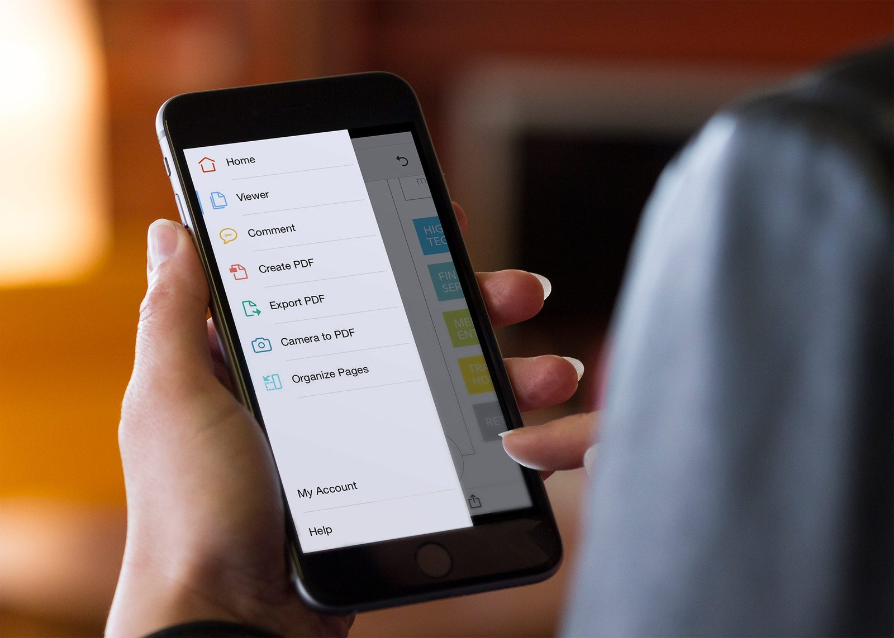

Earlier Process
Directions for Future Research
Benefits of the tool
UNIVERSAL FORM READER
Result and Conclusion
Overview of the code
Modular Analysis
Notes:
Background - https://media.istockphoto.com/vectors/panoramic-view-of-the-mountain-landscape-with-fog-in-the-valley-below-vector-id665568676?k=6&m=665568676&s=612x612&w=0&h=85bhDOA7XaDARIjlXkI4GGqO6PEIvJBsQyNpj3dyV0U=
Stressed Person - https://www.verywellmind.com/thmb/rXR1ZeQRZXEaaHPz_hcWcC6FPOQ=/2145x1397/filters:fill(ABEAC3,1)/stressedman-cbf6c8900b954de2b933018b6ae06ae3.jpg
Happy IT person - https://usercontent2.hubstatic.com/12652087_f120.jpg
Happy Physician - https://images-platform.99static.com//68aXkyfGbZtJszNfLQ-J5A1_yEA=/477x439:1519x1480/fit-in/500x500/99designs-contests-attachments/117/117307/attachment_117307614
Clock - https://listimg.pinclipart.com/picdir/s/485-4856395_clock-clip-art-clock-gif-transparent-background-png.png

Slide 3
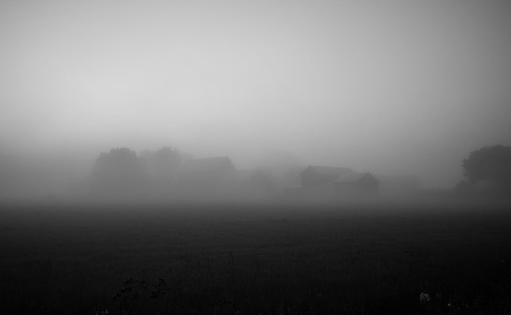
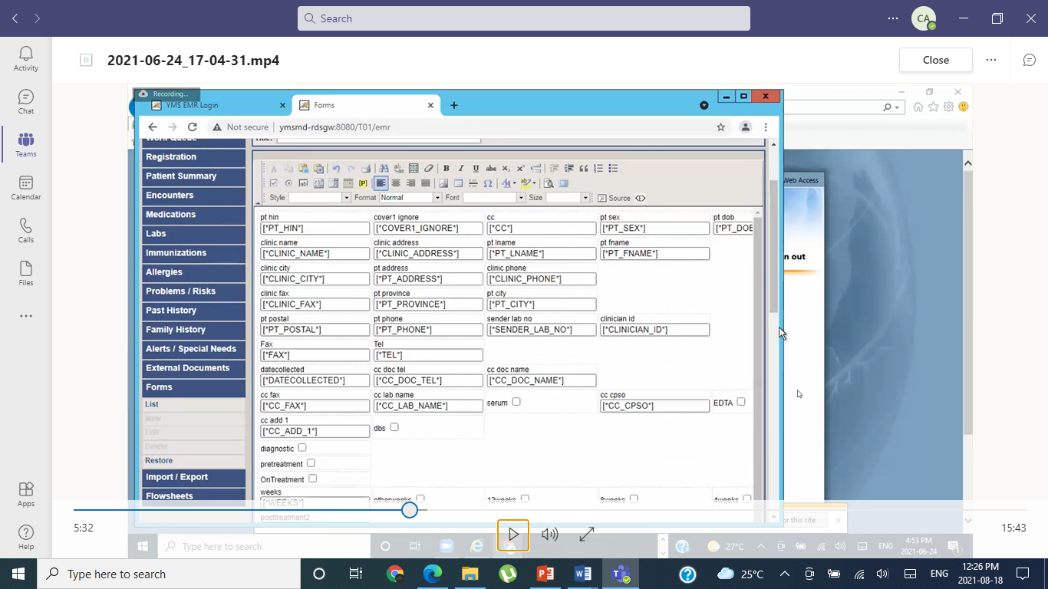
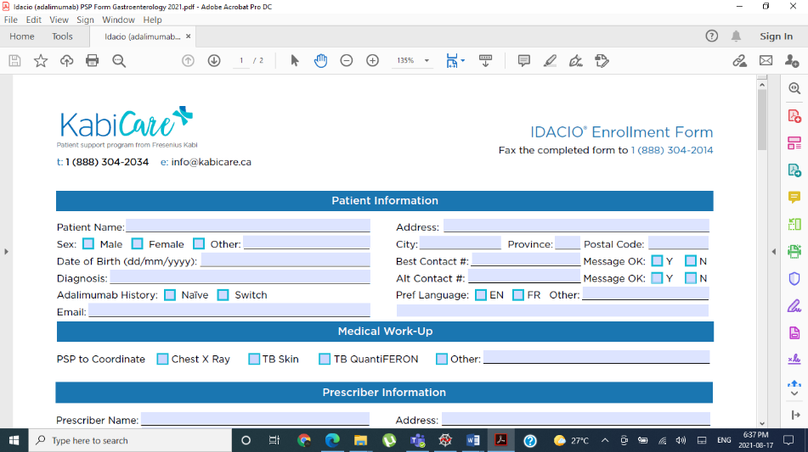


Earlier Process
Required Hours of Manual Effort
Unlock PDF
Make it Fillable
Replicate it on the EMR
Map to Database
12 - 15 Hour/Per Form
Notes:
Background - https://media.istockphoto.com/vectors/panoramic-view-of-the-mountain-landscape-with-fog-in-the-valley-below-vector-id665568676?k=6&m=665568676&s=612x612&w=0&h=85bhDOA7XaDARIjlXkI4GGqO6PEIvJBsQyNpj3dyV0U=
Stressed Person - https://www.verywellmind.com/thmb/rXR1ZeQRZXEaaHPz_hcWcC6FPOQ=/2145x1397/filters:fill(ABEAC3,1)/stressedman-cbf6c8900b954de2b933018b6ae06ae3.jpg
Happy IT person - https://usercontent2.hubstatic.com/12652087_f120.jpg
Happy Physician - https://images-platform.99static.com//68aXkyfGbZtJszNfLQ-J5A1_yEA=/477x439:1519x1480/fit-in/500x500/99designs-contests-attachments/117/117307/attachment_117307614
Clock - https://listimg.pinclipart.com/picdir/s/485-4856395_clock-clip-art-clock-gif-transparent-background-png.png

Slide 4
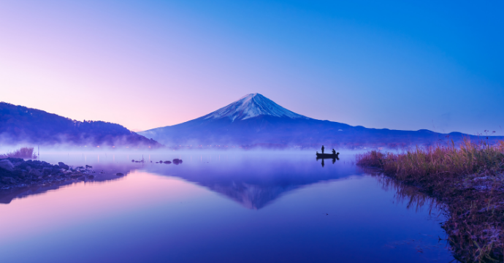

Seneca’s UFR
Features of the Universal Form Reader
Reduced effort in finding labels.
Automatically extract all elements.
Automated HTML generation and easy linking database
Only 2-3 hours per form
Manual Effort reduced by 80%
Notes:
Background - https://media.istockphoto.com/vectors/panoramic-view-of-the-mountain-landscape-with-fog-in-the-valley-below-vector-id665568676?k=6&m=665568676&s=612x612&w=0&h=85bhDOA7XaDARIjlXkI4GGqO6PEIvJBsQyNpj3dyV0U=
Stressed Person - https://www.verywellmind.com/thmb/rXR1ZeQRZXEaaHPz_hcWcC6FPOQ=/2145x1397/filters:fill(ABEAC3,1)/stressedman-cbf6c8900b954de2b933018b6ae06ae3.jpg
Happy IT person - https://usercontent2.hubstatic.com/12652087_f120.jpg
Happy Physician - https://images-platform.99static.com//68aXkyfGbZtJszNfLQ-J5A1_yEA=/477x439:1519x1480/fit-in/500x500/99designs-contests-attachments/117/117307/attachment_117307614
Clock - https://listimg.pinclipart.com/picdir/s/485-4856395_clock-clip-art-clock-gif-transparent-background-png.png
Seneca Reader Background - https://www.exoticca.com/uk/magazine/wp-content/uploads/2021/06/mt.-fuji-BLOG-mountains.png
Snapping fingers -https://image.shutterstock.com/image-vector/snapping-fingers-clip-art-line-260nw-1655566411.jpg

Slide 5

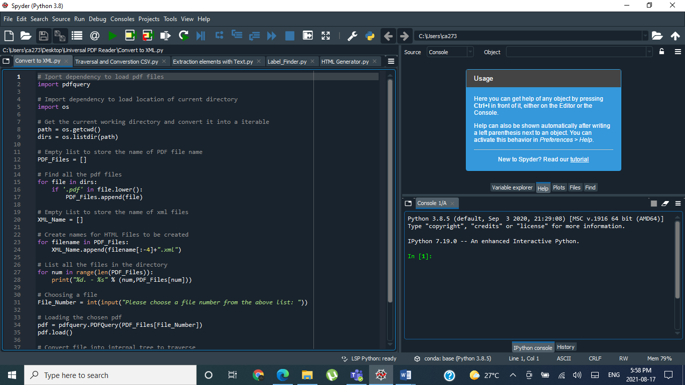
Overview: Introduction to the code
Over the weeks, we at Seneca have developed a tool for YMS using the versatile python language that can:
Read Any Interactive PDF
Convert PDF into XML form
Traverse the tree structure using Decision Tree Algorithm
Find 95% of the interactive elements and 80% of the Text
Generate associated labels with K nearest neighbour algorithm
Generate a ready to upload HTML on the system

Slide 6
Guide to Success
Our approach was to break the problem of getting the HTML from a complex structure of PDF into 3 segments so that we can automate process with the code to our maximum extent.
Challenge 1:
Read the PDF
Challenge 2: Generate Labels
Challenge 3: Generate HTML and Link it with Database

Slide 7
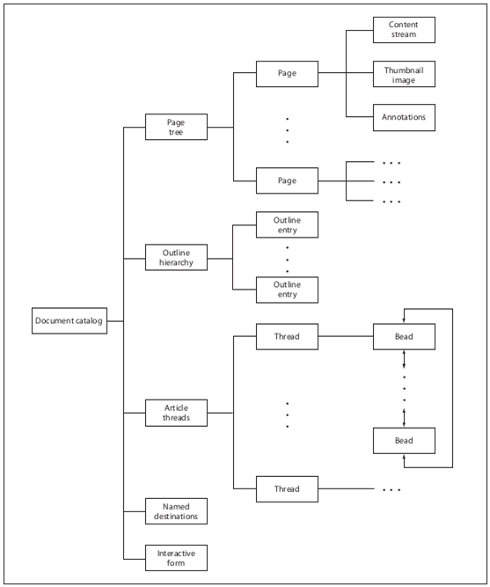
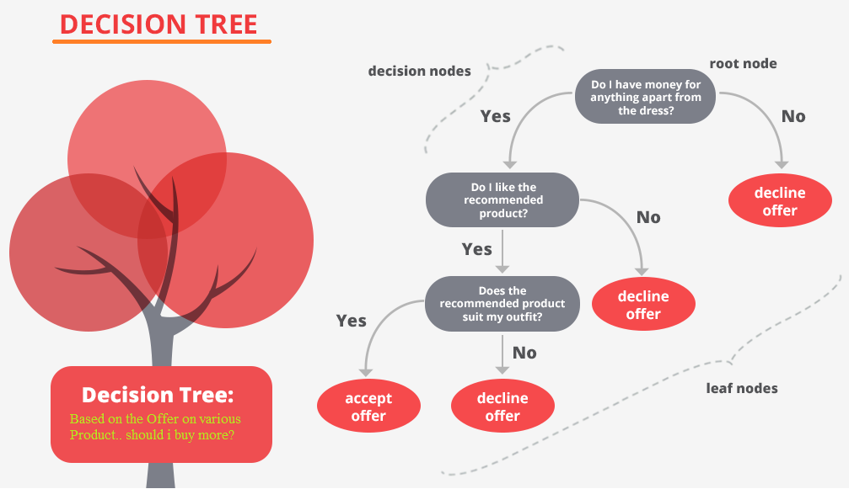
Problem Analysis
Challenge 1: Read the PDF
In a research paper by university of Nottingham, “Creating structured pdfs using XML templates” the different elements of PDFs are explained as branches of a Tree.
Notes:
Reference Link - https://www.google.ca/url?sa=t&rct=j&q=&esrc=s&source=web&cd=&ved=2ahUKEwjtqtmB0r3yAhUJCs0KHa6GDNoQFnoECBUQAQ&url=https%3A%2F%2Fnottingham-repository.worktribe.com%2FOutputFile%2F1020892&usg=AOvVaw27mhMtm_Edc4jD4CQ5hU5t

Slide 8
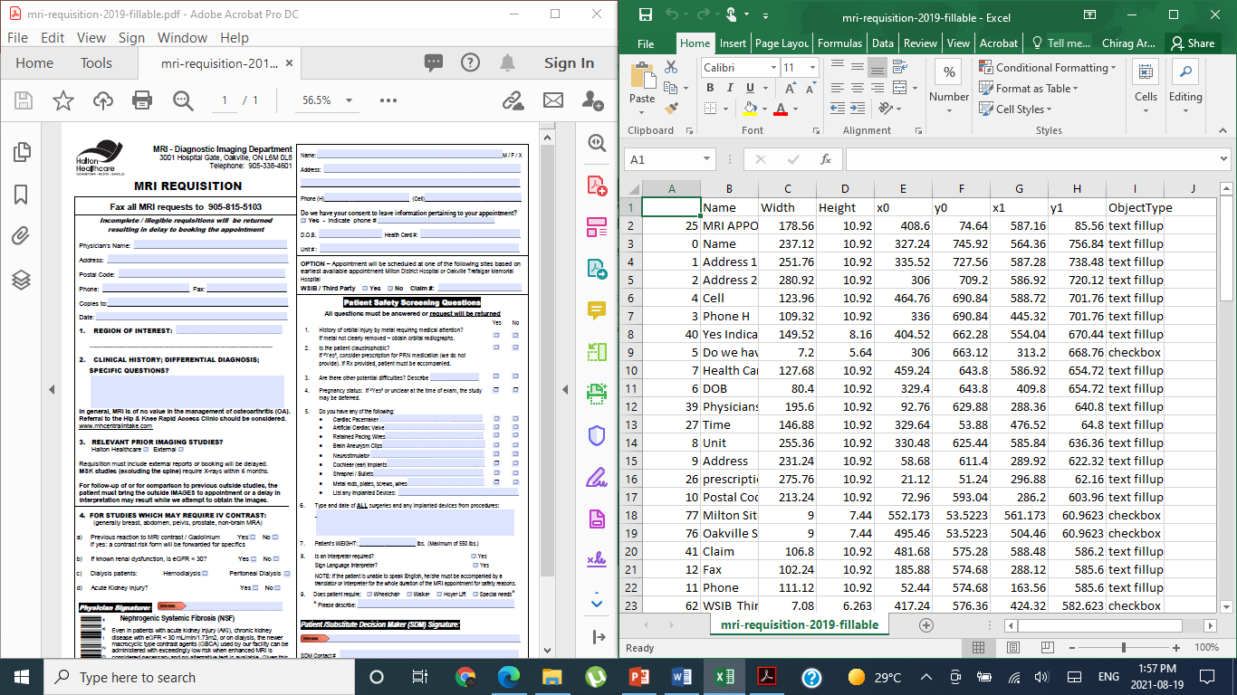
Problem Analysis
Challenge 1: Read the PDF
85% of the elements of the file.
We parse it like a logical tree, sort it using sorting algorithms like insertion sort, store it in a linked structure like dictionaries and concatenate all the elements into a data frame which exported to a CSV file.
Notes:
Reference Link - https://www.google.ca/url?sa=t&rct=j&q=&esrc=s&source=web&cd=&ved=2ahUKEwjtqtmB0r3yAhUJCs0KHa6GDNoQFnoECBUQAQ&url=https%3A%2F%2Fnottingham-repository.worktribe.com%2FOutputFile%2F1020892&usg=AOvVaw27mhMtm_Edc4jD4CQ5hU5t

Slide 9
Problem Analysis
Challenge 2: Generating Labels
Potential Label
Textbox
Potential Label
Potential Label
Potential Label
Notes:
Reference Link - https://www.google.ca/url?sa=t&rct=j&q=&esrc=s&source=web&cd=&ved=2ahUKEwjtqtmB0r3yAhUJCs0KHa6GDNoQFnoECBUQAQ&url=https%3A%2F%2Fnottingham-repository.worktribe.com%2FOutputFile%2F1020892&usg=AOvVaw27mhMtm_Edc4jD4CQ5hU5t

Slide 10
Problem Analysis
Challenge 2: Generating Labels
Potential Label
Textbox
The using the k-means nearest neighbor technique in which we found Euclidian distance between the text/check box and text near the elements and text which is at minimum distance from element is considered label for it.
Notes:
Reference Link - https://www.google.ca/url?sa=t&rct=j&q=&esrc=s&source=web&cd=&ved=2ahUKEwjtqtmB0r3yAhUJCs0KHa6GDNoQFnoECBUQAQ&url=https%3A%2F%2Fnottingham-repository.worktribe.com%2FOutputFile%2F1020892&usg=AOvVaw27mhMtm_Edc4jD4CQ5hU5t

Slide 11
Problem Analysis
Challenge 3: Generate HTML and Link it with Database
First, the HTML generator uses the csv generated from parsing the xml file to generate the interactive elements in html, this generator uses the object type column of csv to generate the different types of interactive elements of pdf.
Notes:
Reference Link - https://www.google.ca/url?sa=t&rct=j&q=&esrc=s&source=web&cd=&ved=2ahUKEwjtqtmB0r3yAhUJCs0KHa6GDNoQFnoECBUQAQ&url=https%3A%2F%2Fnottingham-repository.worktribe.com%2FOutputFile%2F1020892&usg=AOvVaw27mhMtm_Edc4jD4CQ5hU5t

Slide 12
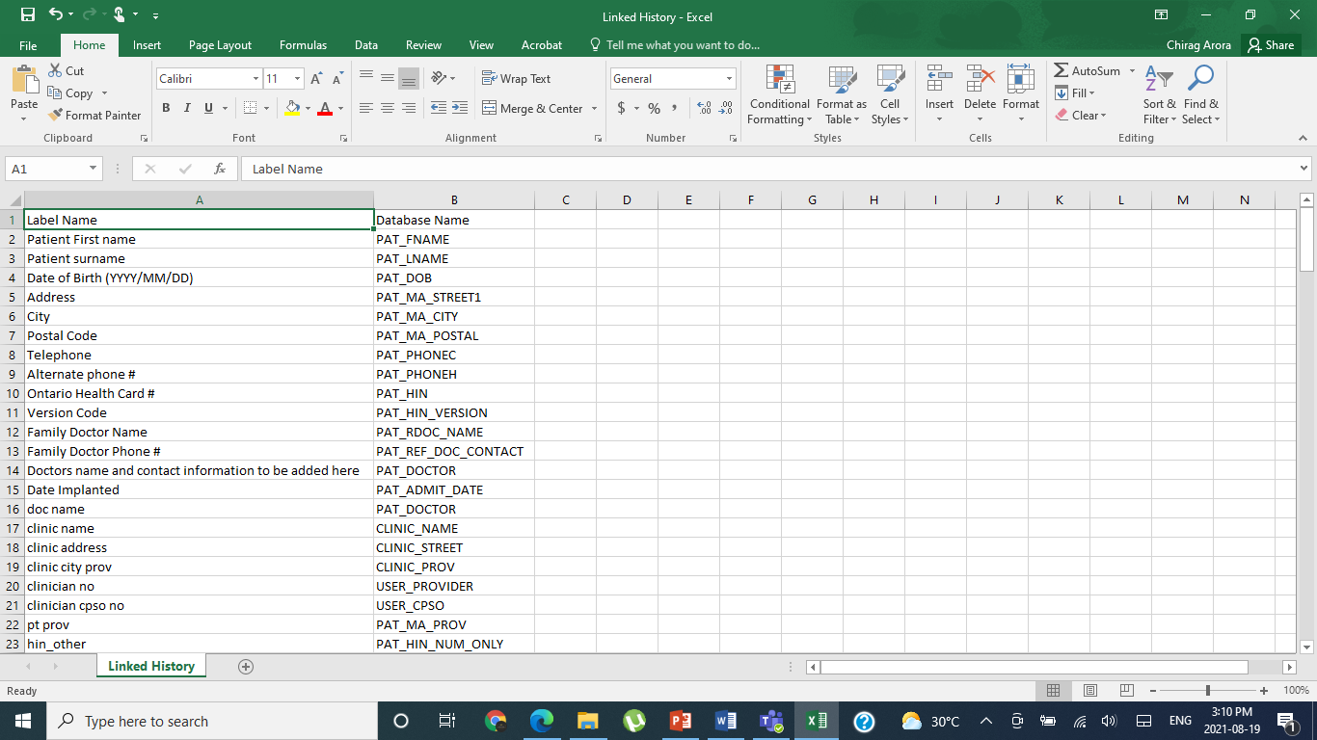
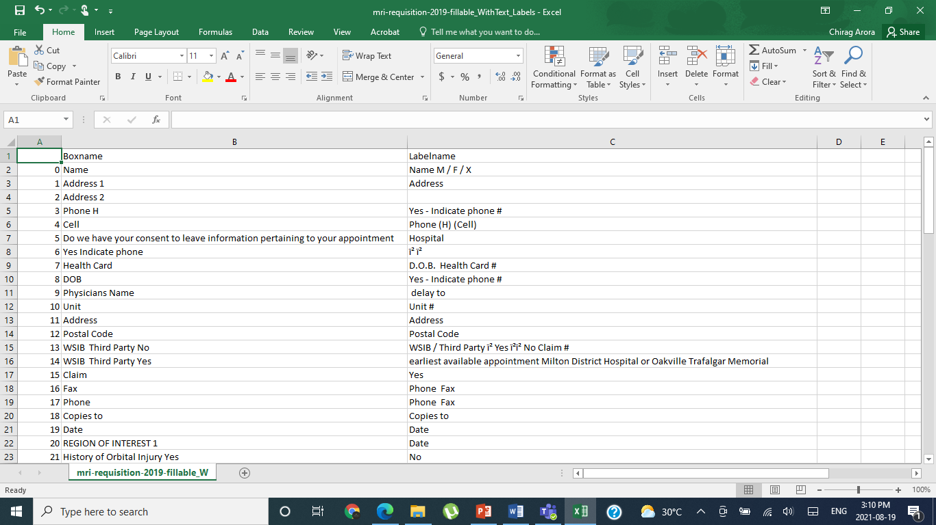
Problem Analysis
Challenge 3: Generate HTML and Link it with Database
Generates the database name
Generates the Label for elements not in History
Linked History is created manually for those elements from 20 pdf files whose database labels are known.
It can be appended by using the code or even manually.
Label Finder is used to give as many as accurate labels (upto 50%) to interactive elements of pdf in html script.
Notes:
Reference Link - https://www.google.ca/url?sa=t&rct=j&q=&esrc=s&source=web&cd=&ved=2ahUKEwjtqtmB0r3yAhUJCs0KHa6GDNoQFnoECBUQAQ&url=https%3A%2F%2Fnottingham-repository.worktribe.com%2FOutputFile%2F1020892&usg=AOvVaw27mhMtm_Edc4jD4CQ5hU5t

Slide 13
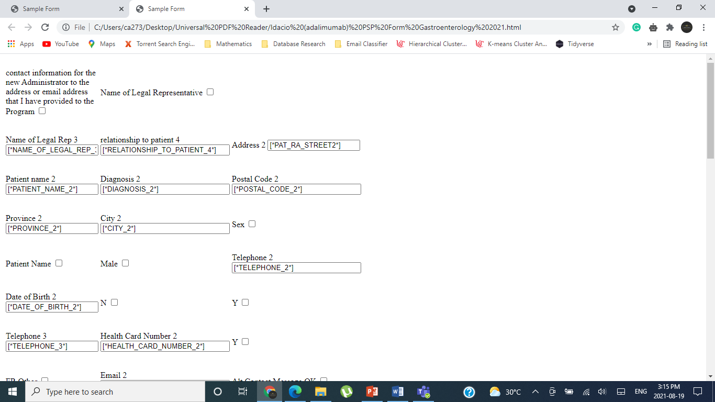
Problem Analysis
Challenge 3: Generate HTML and Link it with Database
Finally it boils down to the HTML syntax which uses a Matrix Table Assignment to fit the elements in position.
This HTML form is then uploaded to the EMR. It is very customizable according the form needs.
Notes:
Reference Link - https://www.google.ca/url?sa=t&rct=j&q=&esrc=s&source=web&cd=&ved=2ahUKEwjtqtmB0r3yAhUJCs0KHa6GDNoQFnoECBUQAQ&url=https%3A%2F%2Fnottingham-repository.worktribe.com%2FOutputFile%2F1020892&usg=AOvVaw27mhMtm_Edc4jD4CQ5hU5t

Slide 14

Results and Conclusion
No doubt there were some exceptional cases where the results were not as desired, but this system worked for 80% of given general pdf files and produced satisfying results. It is believed that the 60-70% of manual efforts will be decreased by this system.
Task | Automation Level | Accuracy
Unlocking PDFs | 0 | 0
Converting PDFs to Fillable | 60% | Adobe accuracy varies between 60 – 70%
Extracting Elements | 85% | 80-100%
Assign the Labels | 50% | 40-50%
Notes:
Reference Link - https://www.google.ca/url?sa=t&rct=j&q=&esrc=s&source=web&cd=&ved=2ahUKEwjtqtmB0r3yAhUJCs0KHa6GDNoQFnoECBUQAQ&url=https%3A%2F%2Fnottingham-repository.worktribe.com%2FOutputFile%2F1020892&usg=AOvVaw27mhMtm_Edc4jD4CQ5hU5t

Slide 15
Results and Conclusion
No doubt there were some exceptional cases where the results were not as desired, but this system worked for 70% of given general pdf files and produced satisfying results. It is believed that the 60-70% of manual efforts will be decreased by this system.
Notes:
Previously, 5% automation comes from using tools like nitro pro to create interactive pdfs and using EMR, where they can drag and drop stuff rather than write code line one by one for each of the elements.

Slide 16
Limitations
Things to keep in mind
Not able to convert non fillable pdf to fillable pdf ( Requires Adobe)
Not 100% accurate while labelling interactive elements
Width of the interactive elements is not the same as of form.
The location of the elements is not exactly the same as the PDF form.
Notes:
Background - https://media.istockphoto.com/vectors/panoramic-view-of-the-mountain-landscape-with-fog-in-the-valley-below-vector-id665568676?k=6&m=665568676&s=612x612&w=0&h=85bhDOA7XaDARIjlXkI4GGqO6PEIvJBsQyNpj3dyV0U=
Stressed Person - https://www.verywellmind.com/thmb/rXR1ZeQRZXEaaHPz_hcWcC6FPOQ=/2145x1397/filters:fill(ABEAC3,1)/stressedman-cbf6c8900b954de2b933018b6ae06ae3.jpg
Happy IT person - https://usercontent2.hubstatic.com/12652087_f120.jpg
Happy Physician - https://images-platform.99static.com//68aXkyfGbZtJszNfLQ-J5A1_yEA=/477x439:1519x1480/fit-in/500x500/99designs-contests-attachments/117/117307/attachment_117307614
Clock - https://listimg.pinclipart.com/picdir/s/485-4856395_clock-clip-art-clock-gif-transparent-background-png.png

Slide 17

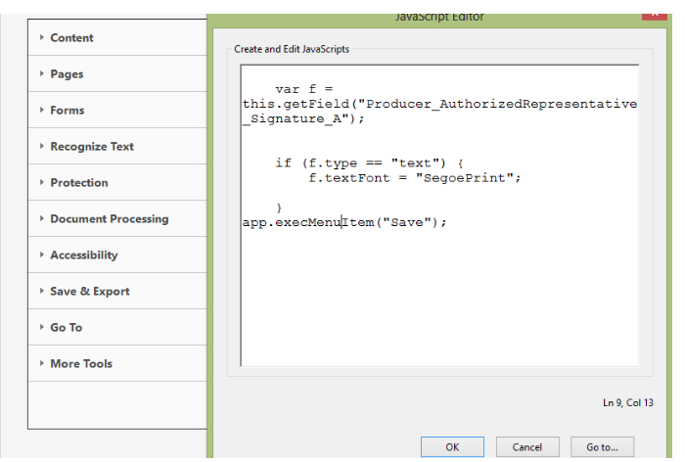

Directions for Future Research
Flask and Rest to Develop API for the Python code
JavaScript to find elements which it cannot be detected by Adobe.
Computer Vision Machine Learning Techniques to extract subheading from images in the form.
Notes:
Reference Link - https://www.google.ca/url?sa=t&rct=j&q=&esrc=s&source=web&cd=&ved=2ahUKEwjtqtmB0r3yAhUJCs0KHa6GDNoQFnoECBUQAQ&url=https%3A%2F%2Fnottingham-repository.worktribe.com%2FOutputFile%2F1020892&usg=AOvVaw27mhMtm_Edc4jD4CQ5hU5t

Slide 18
References
https://listimg.pinclipart.com/picdir/s/485-4856395_clock-clip-art-clock-gif-transparent-background-png.png
https://media.istockphoto.com/vectors/panoramic-view-of-the-mountain-landscape-with-fog-in-the-valley-below-vector-id665568676?k=6&m=665568676&s=612x612&w=0&h=85bhDOA7XaDARIjlXkI4GGqO6PEIvJBsQyNpj3dyV0U
https://www.verywellmind.com/thmb/rXR1ZeQRZXEaaHPz_hcWcC6FPOQ=/2145x1397/filters:fill(ABEAC3,1)/stressedman-cbf6c8900b954de2b933018b6ae06ae3.jpg
https://usercontent2.hubstatic.com/12652087_f120.jpg
https://images-platform.99static.com//68aXkyfGbZtJszNfLQ-J5A1_yEA=/477x439:1519x1480/fit-in/500x500/99designs-contests-attachments/117/117307/attachment_117307614
https://www.exoticca.com/uk/magazine/wp-content/uploads/2021/06/mt.-fuji-BLOG-mountains.png
https://image.shutterstock.com/image-vector/snapping-fingers-clip-art-line-260nw-1655566411.jpg
https://www.google.ca/url?sa=t&rct=j&q=&esrc=s&source=web&cd=&ved=2ahUKEwjtqtmB0r3yAhUJCs0KHa6GDNoQFnoECBUQAQ&url=https%3A%2F%2Fnottingham-repository.worktribe.com%2FOutputFile%2F1020892&usg=AOvVaw27mhMtm_Edc4jD4CQ5hU5t

